Slide 1
Flatiron Data Science Phase 1 Project
Madeleine Reiser
August 24, 2021

Slide 2
Outline
● Business Problem
● Data
● Methods
● Results
● Conclusions

Slide 3
Business Problem
Microsoft wants to create their own movie streaming service and

Slide 4
Box Office Mojo
Dataset
IMDB Datasets
imdb_title_basics
imdb_title_ratings
title
studio
domestic_gross
foreign_gross
year
primary_title
original_title
start_year
runtime_minutes
genres
averagerating
numvotes
tconst

Slide 5
Methods
- Merged the two IMDB datasets
- Dropped rows where average rating is NaN
- Limited years from 2010-2018
- Merge IMDB and BOM datasets
- Correlation Matrix

Slide 6
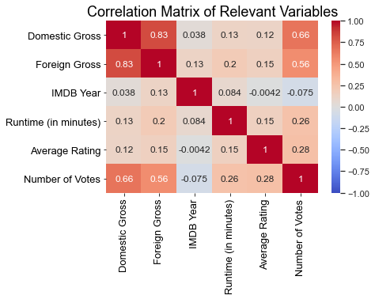
Results

Slide 7
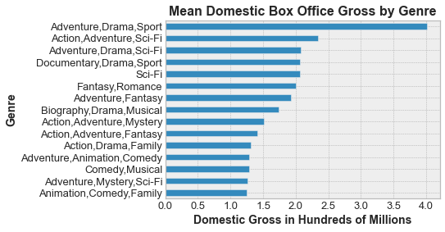
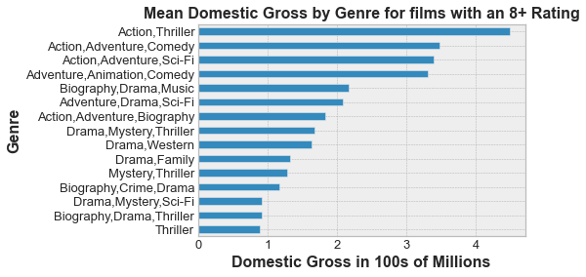
Results

Slide 8
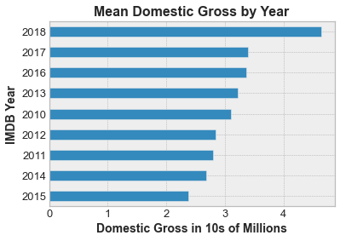
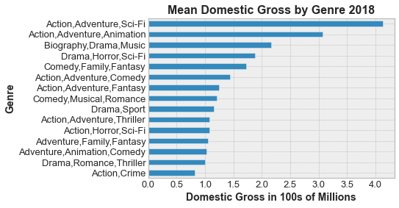
Results

Slide 9
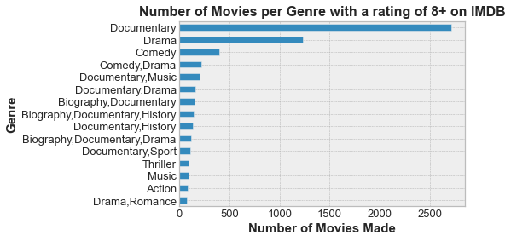
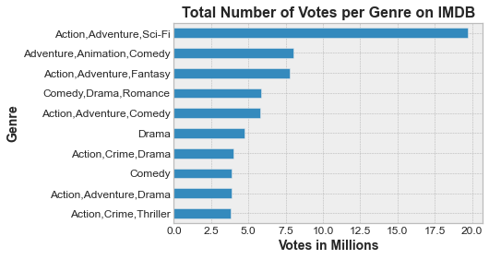
Results

Slide 10
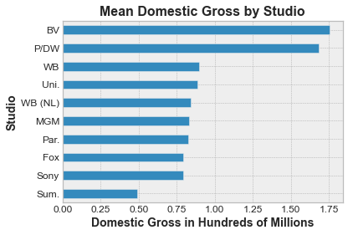
Results

Slide 11
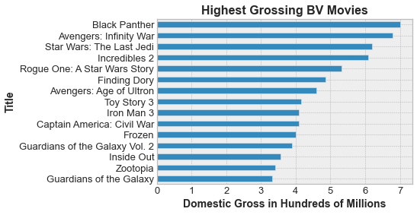
BV Studios

Slide 12
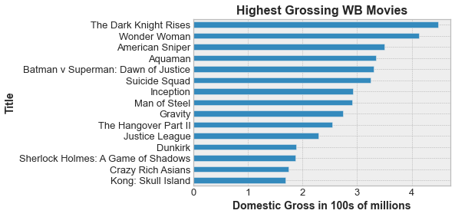
WB Studios

Slide 13
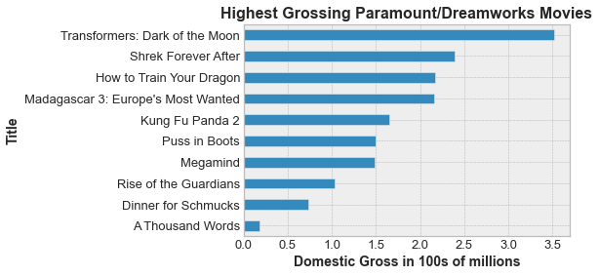
Paramount/Dreamworks Studios

Slide 14
Conclusions
Adventure/Drama/Sport films make the most money in the Domestic Box Office, invest in live sporting events.
Action/Adventure/Sci-fi and Action/Adventure/Animation films are the 2nd and 3rd most profitable genres, those with sequels do the best.
Because Documentaries are the highest rated genre, invest in these as well, for recognition and awards.
In the future, data from 2019 onward would be interesting to look at to see how the film industry was affected by the Covid-19 Pandemic and how they adapted.

Slide 15
Thank you!
Email: reiser.mb@gmail.com
GitHub: @turtleduck18

